Slide 1
COME IN QUIETLY
HAVE ALL SUPPLIES READY WHEN THE BELL RINGS.
Take out your note paper and new piece of paper, pen or pencil.

Slide 2
Objective: Evaluate the importance of the Mayflower Compact and other documents.
Standard 8.1.4: Describe the nation’s blend of civic republicanism, classical liberal principles, and English parliamentary traditions.
Standard 8.2.1: Discuss the significance of the Magna Carta, the English Bill of Rights, and the Mayflower Compact.
RH 8.2: Determine the central ideas or information of a primary or secondary source; provide an accurate summary of the source distinct from prior knowledge or opinions.

Slide 3
Prior Knowledge
You have learned about several documents that led to a change in the way government protects people’s rights or increased citizen participation in government.
Describe how these documents and institutions are important.
Partner A share with Partner B “The _______ are important because _________.”
Partner B share with Partner A “I (agree/disagree) the ________ are important because ______.”

Slide 4
Concept - Definitions
Define:
Compact - a formal agreement or contract between two or more parties.
Burgess - a person chosen to represent the town in the town government.

Slide 5
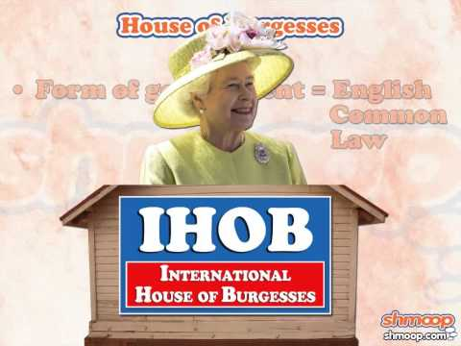
Concept
House of Burgesses
Compact - a formal agreement or contract between two or more parties.
Charter - a written grant by which an institution is created and its rights and privileges defined.
Guaranteed - provide a formal assurance or promise.

Slide 6
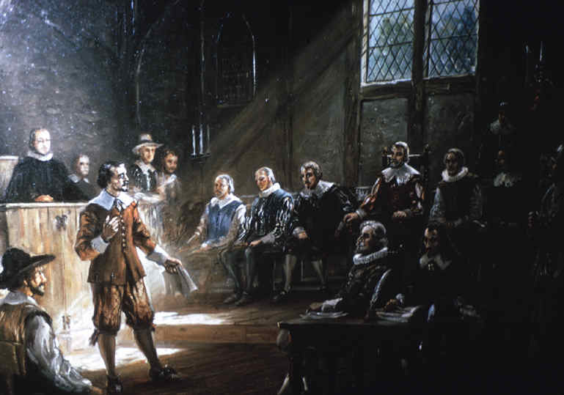
Concept
House of Burgesses
Compact - a formal agreement or contract between two or more parties.
Charter - a written grant by which an institution is created and its rights and privileges defined.
Guaranteed - provide a formal assurance or promise.
The House of Burgesses was founded in Jamestown, Virginia in 1619.
  It was the first Representative body in the English colonies.
  Representatives were chosen to vote on laws and policies for the colony.
  The Representatives were called Burgesses. They met together in the House of Burgesses.
  It served as a model for other colonial legislatures.
Explain the purpose of the House of Burgesses?

Slide 7
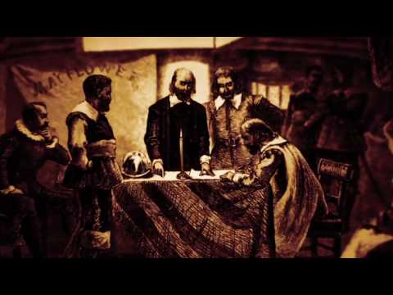
Concept
Mayflower Compact
Compact - a formal agreement or contract between two or more parties.
Charter - a written grant by which an institution is created and its rights and privileges defined.
Guaranteed - provide a formal assurance or promise.

Slide 8
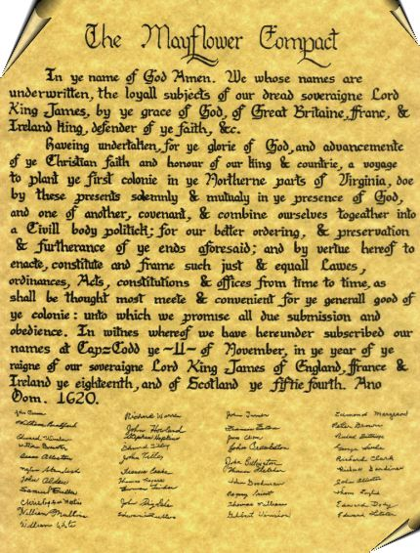
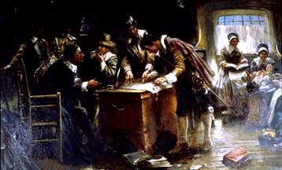
Concept
Mayflower Compact
Compact - a formal agreement or contract between two or more parties.
Charter - a written grant by which an institution is created and its rights and privileges defined.
Guaranteed - provide a formal assurance or promise.
The Mayflower Compact was signed in 1620.
  It was an example of self-rule or self-government in the colonies.
    It was also an example of representative government as the colonists elected their leaders.
  It was written by the Pilgrims before leaving their ship.
  Every family had to agree to sign and abide by the Compact.
    It’s an example of John Locke’s Social Compact.
Explain the importance of the Mayflower Compact.

Slide 9
Skill - I Do
Read the Text and Annotate using the following symbols.
Important Detail or Fact ★
Unfamiliar word or phrase
Interesting or Surprising !
Have a Question ?
Made a Connection C
¹In the name of God, Amen. ²We whose names are underwritten, the loyal subjects of our dread sovereign Lord, King James, by the grace of God, of Great Britain, France, and Ireland, King, Defender of the Faith, etc.,

Slide 10
Skill - We Do
Read the Text and Annotate using the following symbols.
Important Detail or Fact ★
Unfamiliar word or phrase
Interesting or Surprising !
Have a Question ?
Made a Connection C
¹In the name of God, Amen. ²We whose names are underwritten, the loyal subjects of our dread sovereign Lord, King James, by the grace of God, of Great Britain, France, and Ireland, King, Defender of the Faith, etc.,!

Slide 11
Skill - We Do
Read the Text and Annotate using the following symbols.
Important Detail or Fact ★
Unfamiliar word or phrase
Interesting or Surprising !
Have a Question ?
Made a Connection C
³Having undertaken, for the glory of God, and advancement of the Christian faith and honor of our King and Country, a voyage to plant the first colony in the northern parts of Virginia, ⁴do by these presents solemnly and mutually in the presence of God, and one of another, covenant and combine ourselves together into a civil body politic

Slide 12
Skill - We Do
Read the Text and Annotate using the following symbols.
Important Detail or Fact ★
Unfamiliar word or phrase
Interesting or Surprising !
Have a Question ?
Made a Connection C
³Having undertaken, for the glory of God, and advancement of the Christian faith and honor of our King and Country, a voyage to plant the first colony in the northern parts of Virginia, ⁴do by these presents solemnly and mutually in the presence of God, and one of another, covenant and combine ourselves together into a civil body politic

Slide 13
Skill - We Do
Read the Text and Annotate using the following symbols.
Important Detail or Fact ★
Unfamiliar word or phrase
Interesting or Surprising !
Have a Question ?
Made a Connection C
³Having undertaken, for the glory of God, and advancement of the Christian faith and honor of our King and Country, a voyage to plant the first colony in the northern parts of Virginia, ⁴do by these presents solemnly and mutually in the presence of God, and one of another, covenant and combine ourselves together into a civil body politic

Slide 14
Skill - We Do
Read the Text and Annotate using the following symbols.
Important Detail or Fact ★
Unfamiliar word or phrase
Interesting or Surprising !
Have a Question ?
Made a Connection C
³Having undertaken, for the glory of God, and advancement of the Christian faith and honor of our King and Country, a voyage to plant the first colony in the northern parts of Virginia, ⁴do by these presents solemnly and mutually in the presence of God, and one of another, covenant and combine ourselves together into a civil body politic

Slide 15
Skill - You Do
Read the Text and Annotate using the following symbols.
Important Detail or Fact ★
Unfamiliar word or phrase
Interesting or Surprising !
Have a Question ?
Made a Connection C
⁷for our better ordering and preservation and furtherance of the ends aforesaid; ⁸and by virtue hereof to enact, constitute and frame such just and equal laws, ordinances, acts, constitutions and offices, from time to time, as shall be thought most meet and convenient for the general good of the Colony; ⁹unto which we promise all due submission and obedience.

Slide 16
Skill - Independent Practice
Read the Text and Annotate using the following symbols.
Important Detail or Fact ★
Unfamiliar word or phrase
Interesting or Surprising !
Have a Question ?
Made a Connection C
Read and annotate the remaining 2 paragraphs.
Use your annotations to answer the 3 questions at the end of the document.

Slide 17
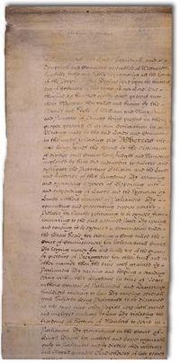
Concept
English Bill of Rights
Compact - a formal agreement or contract between two or more parties.
Charter - a written grant by which an institution is created and its rights and privileges defined.
Guaranteed - provide a formal assurance or promise.
The English Bill of Rights was passed in 1689.
It expanded the Magna Carta by extending protected rights to all English citizens.
It gave England’s Parliament more power than the King.
It protected the right to a trial by jury and outlawed cruel and unusual punishment.
Why was the English Bill of Rights important?

Slide 18
Relevance
Without the progression of increased rights to individuals, as well as representation in government, Americans would not have the Republic or rights they have today.
Why are all these documents important steps to creating the American Republic?

Slide 19
Bringing it together
How did the Magna Carta, House of Burgesses, Mayflower Compact, and English Bill of Rights help lead America to the Constitution and government we have today?

Slide 20
Closure
Explain the purpose of the House of Burgesses.
Describe the importance of the Mayflower Compact.
Discuss the importance of the English Bill of Rights.
Notes:
Do the closure or give Third Quarter CFA 1.

